Slide 1

Extending Applications Safely and Efficiently
Yusheng Zheng¹ • Tong Yu² • Yiwei Yang¹ • Yanpeng Hu³
Xiaozheng Lai⁴ • Dan Williams⁵ • Andi Quinn¹
¹UC Santa Cruz ²eunomia-bpf Community ³ShanghaiTech University
⁴South China University of Technology ⁵Virginia Tech
Notes:
Hello everyone! I'm Yusheng Zheng from UC Santa Cruz, presenting our work on a safe and efficient userspace extension framework.

Slide 2
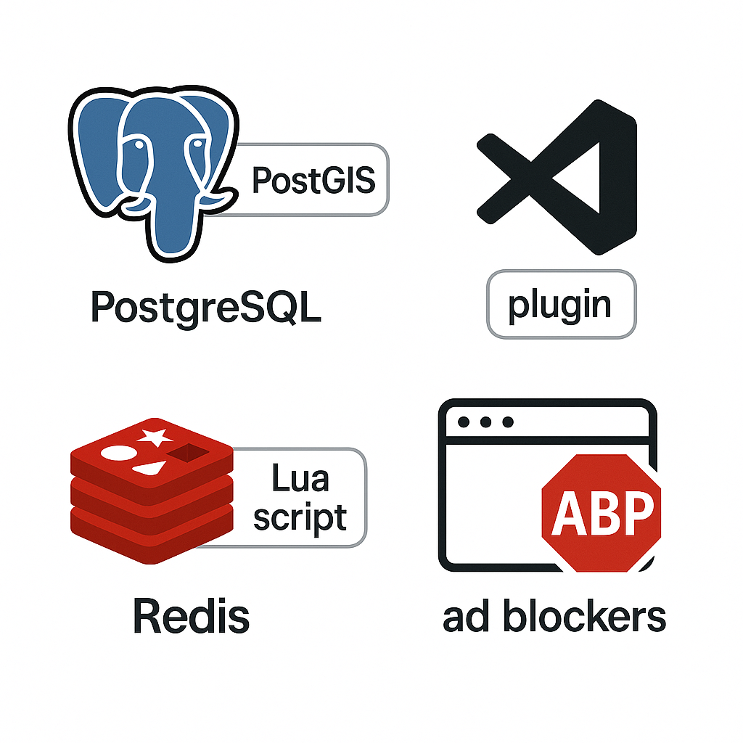
Extensions are everywhere
What are extensions?
Customize software without modifying source code​
Why do we need them?
Easier to maintain and update
Notes:
Extensions are everywhere in modern software.
Extensions allow us to customize software for different deployment needs, without modifying the original application source code.
It can be used to add new functionality, modify behavior, or integrate with external systems.
People use extensions instead of modifying the source code because it is easier to maintain and update their systems.

Slide 3
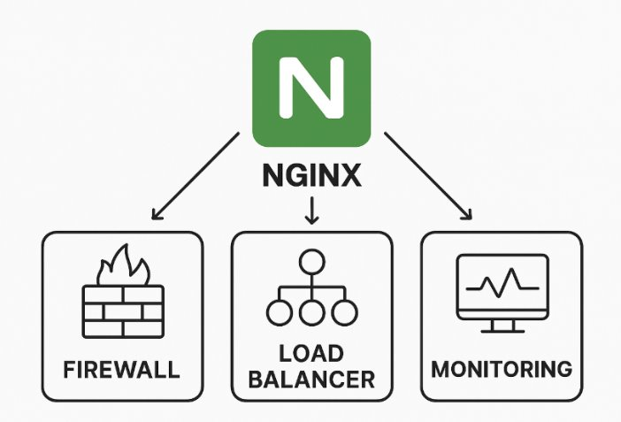
Nginx firewall example
Before deployment, user:
Writes firewall using nginx APIs
Associates firewall with request processing extension entry.
During runtime, Nginx:
Jumps to firewall when reaching request processing entry.
Executes firewall in the extension runtime execution context.
Nginx
Extension Runtime
Entry
Firewall
Notes:
Take Nginx as an example.
Different Nginx deployments need different extensions: some need firewalls to block malicious requests, others need load balancers to distribute traffic, and many need monitoring for observability.
Consider a user wants to deploy a firewall extension to block malicious requests.
Here's how the firewall extension execution model works in Nginx.
Before deployment, the user writes firewall logic using Nginx APIs and associates the firewall with request processing extension entries.
During runtime, when Nginx reaches a request processing entry, it jumps to the firewall extension.
The firewall executes in the extension runtime execution context, analyzing the request and deciding whether to block or allow it.
Once the firewall completes its security checks, execution returns to Nginx's core processing.

Slide 4
Extension Problems & requirements
Real-world safety violations:
Bilibili CDN outage, Apache buffer overflow, Redis RCE
Performance penalty:
WebAssembly/Lua impose 10-15% overhead
Requirements:
Fine-grained safety and interconnectedness trade-offs
Isolation
Efficiency
Efficiency (Performance penalty)
Host
Extension Runtime
Entry
Extension
fine-grained safety/interconnectedness tradeoffs (Safety violation)
Isolation (Safety violation)
Notes:
Extension frameworks need three key features, as shown in the figure.
First, fine-grained safety/ interconnectedness trade-offs.
Extensions need to interact with applications by reading data and calling functions.
For example, a firewall extension needs to read request headers and decide whether to block or allow the request, while a monitoring extension need read-only access.
However, allowing too much interconnecteness comes with risks:
real world incidents shows production outages from safety violations in nginx, apache, and redis extensions.
So, system managers want to specify safety/interconnectedness tradeoffs that allow only the minimum permissions each extension needs.
Second, extension frameworks need isolation to protect extensions from application bugs. We use extensions to provide security guarantees, so isolation is paramount for correctness.
Third, efficiency. Extensions often run on critical paths where every millisecond matters for user experience, so we need them to be quick.

Slide 5
State-of-the-Art Falls Short
Dynamic loading: efficiency but no isolation or fine-grained safety-interconnectedness policies (LD_PRELOAD, DBI tools)
Software Fault Isolation: safety with 10–15 % performance penalty​ (XFI [OSDI 06], NaCL [SOSP 09], RL-Box [USENIX Security 20], Wasm and Lua)
Subprocess: strong isolation but high IPC overhead （Wedge [NSDI 08], Shreds [IEEE SP 16], lwC [OSDI 16], and Orbit [OSDI 22])
Kernel eBPF uprobes: isolation at micro second-level trap cost​, low efficiency
Notes:
Unfortunately, existing approaches cannot satisfy all requirements at the same time.
Dynamic loading and native execution achieves better speed but provides no isolation or fine-grained safety-interconnectedness policies.
Software Fault Isolation systems like WebAssembly deliver safety but carry 10–15 percent performance penalties.
Subprocess isolation ensures separation but has higher IPC overhead.
eBPF in kernel can also be used for userspace extensions, but Kernel eBPF uprobes offer isolation but trap into the kernel on every invocation, make it less efficient.

Slide 6
Contributions
Extension Interface model (EIM)
Bpftime
Navigate fine-grained safety/interconectedness trade-offs for extensions
Efficient support for EIM and isolation through userspace eBPF runtime
Up to 6x less overhead than current state-of-the-art!
Notes:
We present a two-part solution that addresses all three requirements.
First, to help navigate fine-grained safety/ interconnectedness trade-offs, we create the Extension Interface Model, or EIM.
EIM treats every extension capability as a named resource and uses a two-stage specification approach.
Second, We created bpftime, a new userspace eBPF runtime that provides efficient support for EIM and isolation.
It uses three key techniques: eBPF verification for zero runtime safety checks, MPK for isolation, and concealed extension entries that reduce performance overhead.
Together, they provide safety with efficiency while maintaining eBPF compatibility with kernel and existing eBPF tools.
Our evaluation on six real-world applications shows bpftime achieves all three requirements: fine-grained safety controls, strong isolation, and efficiency with up to 6 times better performance compared to solutions like WebAssembly.

Slide 7
Outline
Background & motivation: Extensions
→ Extension Interface Model (EIM): Fine-grained Interface
bpftime Runtime: safety & performance
Evaluation
Notes:
Now that we've discussed the motivation of the problems and challenges, let 's get into EIM.

Slide 8

EIM: Extension Interface Model
Challenge:
Enable fine-grained safety/interconnectedness trade-offs
Solution:
Two-phase specification (Development Time and Deployment Time)
Model all resources as capabilities
Host Application
Extension
Verify
Development time
EIM Spec
Deployment
time
EIM Spec
Writes
Extension Runtime
Writes
Entry
App Developer
Extension
Manager
Entry
During Development
2. Before Deployment​
At Deployment/Runtime​
Notes:
The goal of EIM is to enable fine-grained trade-offs between safety and interconnectedness.
This is challenging because safety/interconnectedness trade-offs are a per-deployment decision. It depend on what the person deploying the system wants to enable or choose.
But, the person deploying the system is not a developer of the system, so they lack application expertise, they don't know what extension features should be allowed by the application.
EIM's solution to this challenge is a two-phase specification. We model all resources as capabilities and split the process into a development phase and a deployment phase.
It works like this.
During Development, the application developer, who understands the host application's internal details, defines the possible interaction points for extensions.
They create a Development-Time EIM Spec, which lists all the functions an extension could call or data it could access.
Before Deployment, the extension manager, who understands the specific needs of a deployment, is responsible for security and configuration.
They review the capabilities offered and create a Deployment-Time EIM Spec. This spec grants the minimal set of privileges an extension actually needs to do its job, following the principle of least privilege.
Finally, when the extension is deployed, the Extension Runtime uses the deployment spec to verify that the extension only performs allowed operations. This ensures that policies are enforced at runtime.

Slide 9
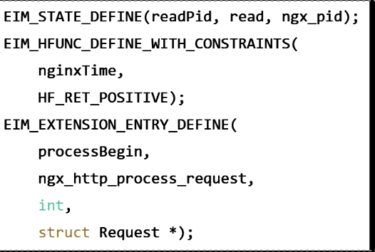
EIM: Development Time Specification
Developers annotate code for capabilities
Automatically extracted into capability manifest
Host Application
Development time
EIM Spec
Writes
Entry
App Developer
Entry
During Development
Notes:
Now let me show you how EIM works in practice, using Nginx as an example.
During development time, Nginx developers annotate their code to declare what extensions could possibly do.
They can add a state capability called readPid for accessing the process ID, a function capability nginxTime() for getting timestamps, complete with pre- and post- hore logic conditions, and extension entries like processBegin when request processing starts.
These annotations can be put into the code, compiled into the binary, and automatically extracted.
This happens once during development and creates a complete map of what extensions can access.
The key insight is that developers only declare possibilities—they don't decide what actually gets used.

Slide 10
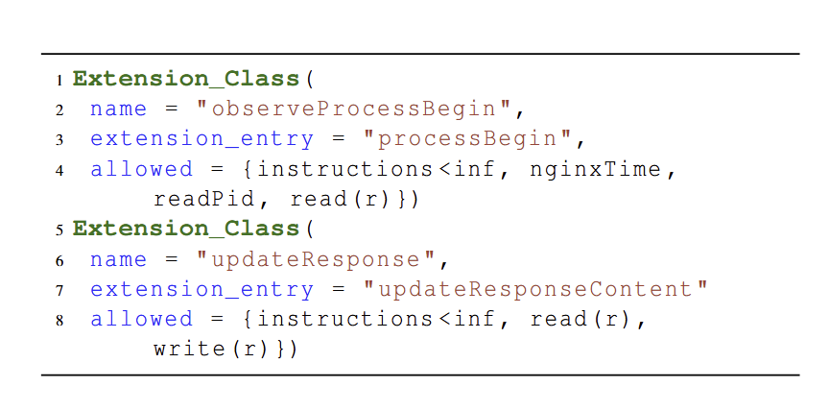
EIM: Deployment Time Specification
YAML policies specify safety/interconnectedness tradeoffs
Compact policies (avg of 30 lines in evaluation).
Deployment
time
EIM Spec
Writes
Extension
Manager
2. Before Deployment​
Notes:
At deployment time, the extension manager writes simple YAML policies that grant minimal privileges to each extension, enabling fine-grained safety-interconnectedness trade-offs.
For example, an observability extension might only read request data and call logging functions, while a firewall extension needs both read and write access to modify responses.
These policies live completely outside the application code. You can adjust the safety-interconnectedness balance per extension without recompiling. The policy is typically compact, like in 30 lines of YAML.

Slide 11
Outline
Background & motivation: Extensions
Extension Interface Model (EIM): Fine-grained Interface
→ bpftime Runtime: safety & performance
Evaluation
Notes:
In the next part, I will introduce our new userspace eBPF extension framework called bpftime.

Slide 12
bpftime: userspace eBPF extension framework
Challenge:
efficiently support EIM and isolation
Solution:
exploit eBPF-style verification, binary rewriting, and hardware features
Intra-process extensions for efficiency
Hardware features for efficient isolation [ERIM USENIX19 ]
Verification for efficient
EIM support
Process
Compatible with eBPF
Concealed extension entries use binary rewriting for efficiency​
Host
bpftime
Runtime
bpftime Loader
Entry
Extension
verifier
eBPF app
Notes:
Our goal here is to efficiently support EIM and isolation for userspace extensions.
Now you might ask, "Can't we just use existing frameworks, like wasm extension framworks to enforce EIM policies?"
You can try to implement EIM on them, but unfortunately, as we discussed in the previous work, current frameworks use heavyweight techniques for safety and isolation, which introduces significant performance overhead.
So, our solution is a new design that combined verification, binary rewriting, and hardware features to enable efficient intra-process extensions.
We are using eBPF here because it provides verification based safety and a rich ecosystem we can reuse.
Let me walk you through how we achieve this with the bpftime framework.
An eBPF application, same as kernel eBPF Application, acts as our extension. The eBPF appluication is first running on the bpftime Loader. This loader includes a verifier that performs (1) verification for efficient EIM support. By checking the eBPF code against the specifications before execution, we can enforce our EIM policies with zero runtime overhead.
To maintain isolation between the host and the extension, we use (2) hardware features like Intel MPKs. This prevents extensions from accessing unauthorized memory and protects the host application from buggy or malicious extensions, and vice-versa.
For invoking extensions, the (3) conceal extension entries using binary rewriting for efficiency. Instead of heavyweight hooks, we patch the host application with lightweight trampolines that redirect execution to the extension at the right moment. This is similar to how kernel eBPF uprobes work but entirely in userspace.
As you can see, the Host application and the extension run in the same process, which enables (4) intra-process extensions for efficiency, eliminating cross-process communication costs.
Finally, our entire framework is (5) compatible with eBPF. Existing eBPF applications and toolchains work with bpftime out of the box. This compatibility also allows user-space extensions to communicate with kernel-space eBPF programs, enabling powerful, full-system observability and control.

Slide 13
Outline
Background & motivation: Extensions
Extension Interface Model (EIM): Fine-grained Interface
bpftime Runtime: safety & performance
→ Evaluation
Notes:
Now, let me show you how bpftime works in practice, and our evaluation results.

Slide 14
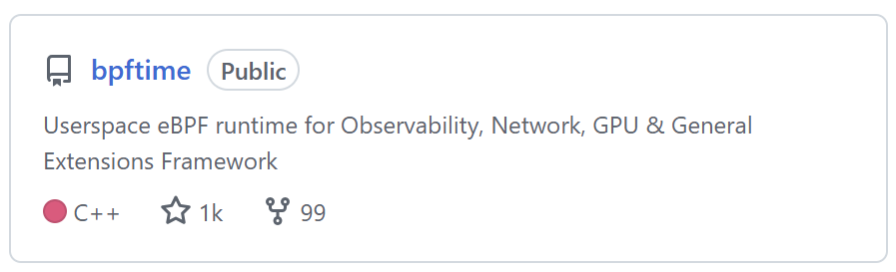
Six Real-World Use Cases
GitHub: https://github.com/eunomia-bpf/bpftime​
Customization
Nginx Firewall
Redis Durability
FUSE Metadata Cache
Observability
DeepFlow
Syscount
Sslsniff
Notes:
bpftime is open source on GitHub with an active community, with thousands of stars and many users.
We built six real-world applications to demonstrate how people are actually using it.
First, we use extensions to customize applications, including an Nginx firewall, a Redis optimization, and a FUSE cache.
Second, we use extensions for observability, by adapting existing tools like DeepFlow, syscount, and sslsniff.
You can find more details in our paper, but due to time limits, I will focus on just two examples.

Slide 15
Customization: Nginx firewall
better
5× to 6× less overhead than lua or WebAssembly
Notes:
We implement an Nginx firewall with EIM and bpftime and compare it with different extension approaches. In this diagram, higher is better.
Lua and WebAssembly extensions impose 11–12 percent throughput loss—that's significant overhead that many operators can't accept in production. Plus, these older methods don't let you control safety and interconnectedness trade-offs like EIM does.
bpftime achieves only 2 percent overhead. That's a 5 times to 6 times improvement over existing approaches.

Slide 16
Observability: sslsniff
better
Maximum 21% less overhead than kernel eBPF
Notes:
Then we use bpftime for sslsniff, which monitors encrypted TLS traffic, as part of the bcc eBPF tools and compare to kernel eBPF.
We run sslsniff on an nginx deployment to test different data sizes from 1K to 256K bytes. The y-axis shows throughput, where higher is better. You can see the performance difference is most clear with 1K data size.
With kernel eBPF, this monitoring costs 28 percent throughput loss. That's too much overhead for production use. With bpftime, the same monitoring functionality costs only 7 percent overhead.

Slide 17
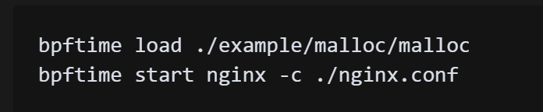

Contributions
Questions?
Extension Interface model (EIM)
Bpftime
Navigate fine-grained safety/interconectedness trade-offs for extensions
Efficient support for EIM and isolation through userspace eBPF runtime
Up to 6x less overhead than current state-of-the-art!
Notes:
In summary, our contributions are EIM and bpftime. EIM enables fine-grained safety/interconnectedness trade-offs that allow you to specify least-privilege policies without touching application source code.
And bpftime supports efficient safety/interconnectedness tradeoffs and isolation with near-native performance using offline verification, Intel MPK, and dynamic binary rewriting.
bpftime is open-source at GitHub, you can scan the QR code to see it. It's fully compatible with the eBPF ecosystem, you can get started by running it as a drop-in replacement for eBPF commands.
I'm happy to take your questions.

Slide 19
Backup

Slide 20
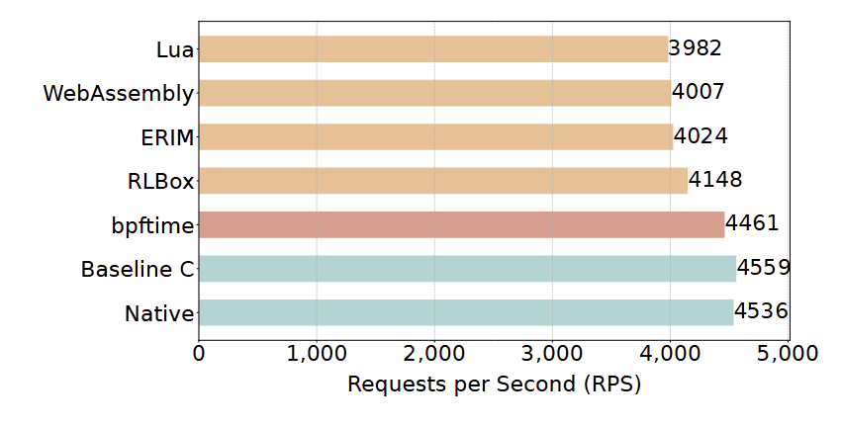
Customization: Nginx firewall
5× to 6× improvement
Less is better
Notes:
Add figture for nginx and make less shorter
The spec is in eim

Slide 21
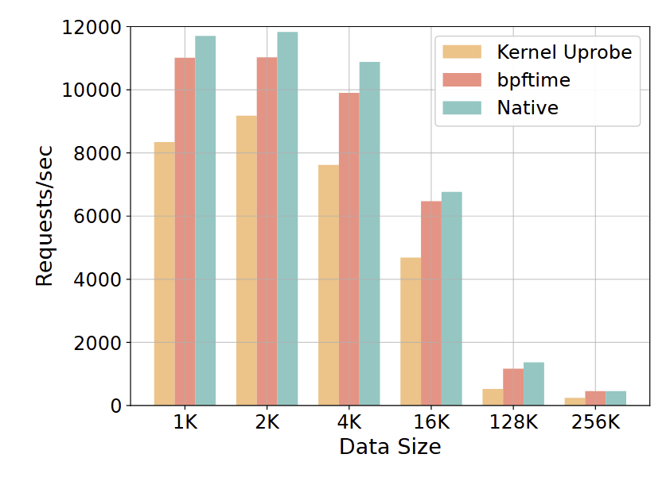
Observability: sslsniff
21% less overhead than kernel eBPF
Notes:
Keep the sslsniff figure, highlight it

Slide 22
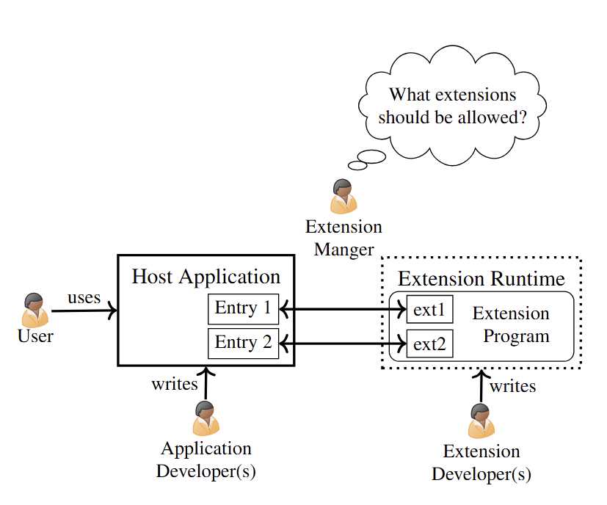
Four Roles in an Extension Ecosystem
Notes:
Put it later
Maybe not need? Or put it in eim and nginx example

Slide 23
Micro-Benchmark
Compare with eBPF:
Uprobe Dispatch: 2.56 µs → 190 ns (14× faster)
Syscall Tracepoint: 151 ns → 232 ns (1.5× slower)
Memory access (Table 3): user-space read/write 2 ns vs 20 ns (10× faster)
Overall: average 1.5× faster than ubpf/rbpf (Figure 11)
Notes:
Remove it
Take it as one sentence inline into design to say why it's much more faster

Slide 24
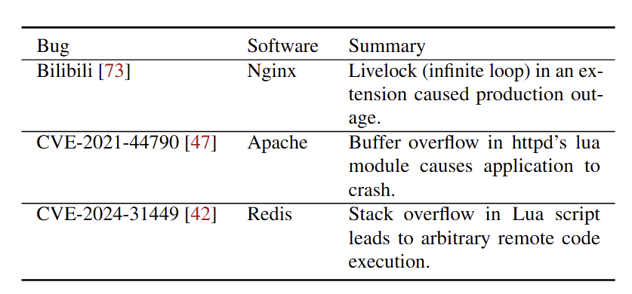
Extensions have issues
Example issues caused by extension safety violations
The performance penalty of existing approaches
Notes:
Make it less and merge it with key requirement
Skip the table
Merge it with 7

Slide 25
Nginx example
ddd
Notes:
Add an example, like nginx example
Role example is too complex, a simple example can go first
3 min to understand the background of it

Slide 26
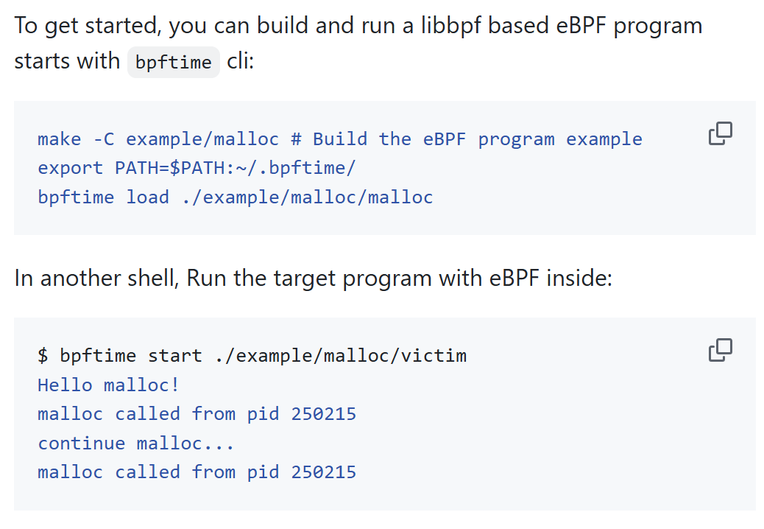
Get started
Use uprobe to monitor userspace malloc function
Try eBPF in GitHub codespace!(Unprivilidged container)

Slide 27
Loader & Runtime Workflow
Intercept standard eBPF syscalls from libbpf/bcc.
Parse EIM manifests and DWARF/BTF to generate constraints.
Verify byte-code via kernel’s eBPF verifier with added assertions.
JIT-Compile verified byte-code into native x86.
Inject user-runtime via ptrace + Frida + Capstone trampolines.
Execute extension: flip MPK key → jump to code → flip back → resume.
Notes:
Maybe remove it

Slide 28
Efficient Safety & Isolation
The eBPF compatibility challenge:
Linux eBPF has tightly coupled components (compilers, runtime, kernel)
Prior user eBPF failed by re-implementing entire stack
bpftime solution: Interpose on eBPF syscalls only
Key design principles:
Lightweight EIM enforcement
Concealed extension entries: 10× faster uprobe
Notes:
Replace with key tech and challenge 1. mpk/ verify 2. hook

Slide 29
Contribution
Extension Interface Model (EIM): Fine-grained capability control
bpftime Runtime: Kernel-grade safety with library-grade performance
Notes:
Like roadmap
Say what is eim and what is bpftime
See the slide and understand the struct
Roadmap can be after
Roadmap is a signal for back to abstractions

Slide 30
State-of-the-Art Falls Short
Approach | Safety | Isolation | Efficiency | Fine-Grained Control
Dynamic Loading | ✗ | ✗ | ✓ | ✗
SFI (Wasm, Lua) | Limited | ✓ | ✗ (10-15% overhead) | ✗
Subprocess | ✓ | ✓ | ✗ (context switches) | Limited
eBPF uprobes | ✓ | ✓ | ✗ (kernel traps) | Limited
No single framework satisfies all requirements
Notes:
Tight up and using a table?
Or using not efficient/ not ...

Slide 31
Summary of EIM
Existing frameworks → no control OR coarse-grained bundles
Treats safety and interconnectedness as independent dimensions
Example policies:
Monitoring extension: read-only access to specific variables
Firewall extension: read/write for response modification

Slide 32
bpftime - Why We Need a New Runtime
Can't existing frameworks enforce EIM efficiently?
WebAssembly/SFI: 10-15% overhead, Subprocess isolation: Expensive switches, Kernel eBPF uprobes: Kernel traps
A userspace extension framework in eBPF
Compatibility and Work together with kernel eBPF extensions
verification for safety
Conceal for efficient
Mpk for isolation
Notes:
Abstraction level
Relook at design
"every slide have one key point, not 2"
How to explain each slide in one sentence? If not, split it into 2

Slide 33
Target process
UbiBPF Loader
uprobe
eBPF Program
Source Code
eBPF application
Binary Rewriter
UbiBPF
user
runtime
userspace tracepoint
eBPF bytecode
JIT compiler
Syscall tracepoint
eBPF compiler
libbpf
verifier
Userspace
Syscall Interposition
UbiBPF maps
syscall
Kernel
verifier
tracepoint
eBPF
runtime
JIT compiler
kprobe
socket

Slide 34
Target process
bpftime Loader
User ext
Entry
Binary Rewriter
bpftime
runtime
eBPF app
JIT compiler
Userspace
verifier
Syscall Interposition
bpftime maps
Kernel
verifier
eBPF
runtime
Kernel ext
Entry (kprobe...)
JIT compiler

Slide 35
Target process
bpftime Loader
User ext
Entry
Binary Rewriter
bpftime
runtime
eBPF app
JIT compiler
Userspace
verifier
Syscall Interposition
bpftime maps
Kernel
eBPF
runtime

Slide 36
Target process
bpftime Loader
Conceal
Entry (Uprobe..)
Binary Rewriter
bpftime
Runtime
(mpk)
eBPF app
JIT compiler
Userspace
verifier
Syscall Interposition
bpftime maps
Kernel

Slide 37
Target process
bpftime Loader
User ext
Entry
Binary Rewriter
bpftime
runtime
eBPF app
JIT compiler
Userspace
verifier
Syscall Interposition
bpftime maps
Kernel

Slide 38
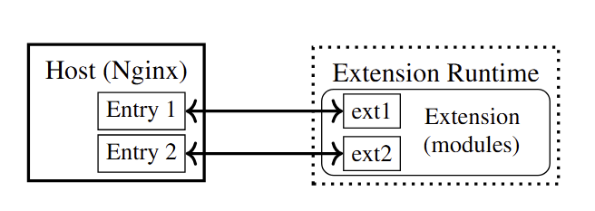
Target process ​
eBPF app
bpftime Loader
verifier
Target process
Conceal
Entry (Uprobe..)
bpftime
Runtime
(mpk)

Slide 39
Target process
eBPF app
Conceal
Entry (Uprobe..)
bpftime
Runtime
(mpk)
bpftime Loader
verifier

Slide 40
Nginx firewall example
User wants to have a firewall to block malicious requests
User write custom firewall logic using nginx helper functions
Load their extension at an extension entry for request pr
Extension execution model: Thread → Extension entry → Jump to extension → Execute by extension runtime → Return to host
Notes:
Too many examples, what are they? Why we want them?
Popular / high level exampl
What is ext
why we care about them

Slide 41
EIM: Extension Interface Model
Solution to nav fine-grained safety-interconnectedness trade-offs
Two-Phase Specification
Development-Time (by Developer)
Deployment-Time (by Manager)
Capabilities as Resources
Notes:
Introduction roles before it?
Modify the roles fig, make it simple and put it here
Can cite something here
Reintroduce it using nginx example, make everything around nginx

Slide 42
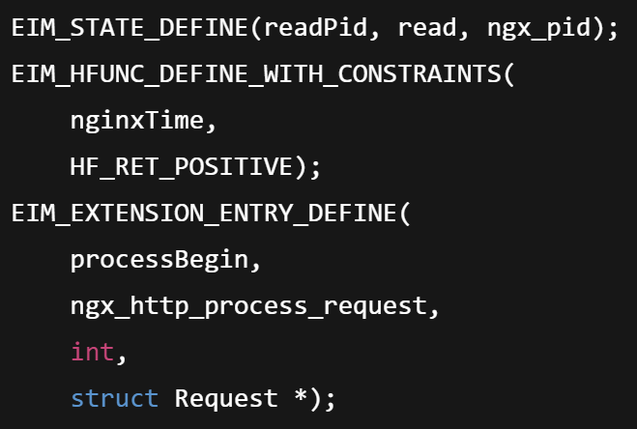
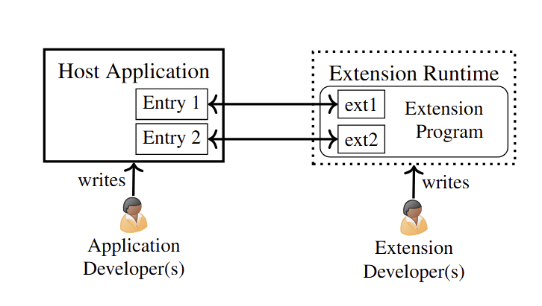
EIM: Development-Time Specification
Developers annotate code for capabilities
Automatically extracted into capability manifest
Notes:
Maybe shorter annotation example? I think it needs one
We can redraw and make it much shorter
Tell people to look at paper and we are not talking about some detail
Do need some abstract
Looks like source code but it's a picture, no need to detail
Show they are short and what people are doing on it

Slide 43







EIM: Extension Interface Model
Solution to nav fine-grained safety-interconnectedness trade-offs
Two-Phase Specification
Development-Time (by Developer)
Deployment-Time (by Manager)
Capabilities as Resources
Notes:
Introduction roles before it?
Modify the roles fig, make it simple and put it here
Can cite something here
Reintroduce it using nginx example, make everything around nginx

Slide 44
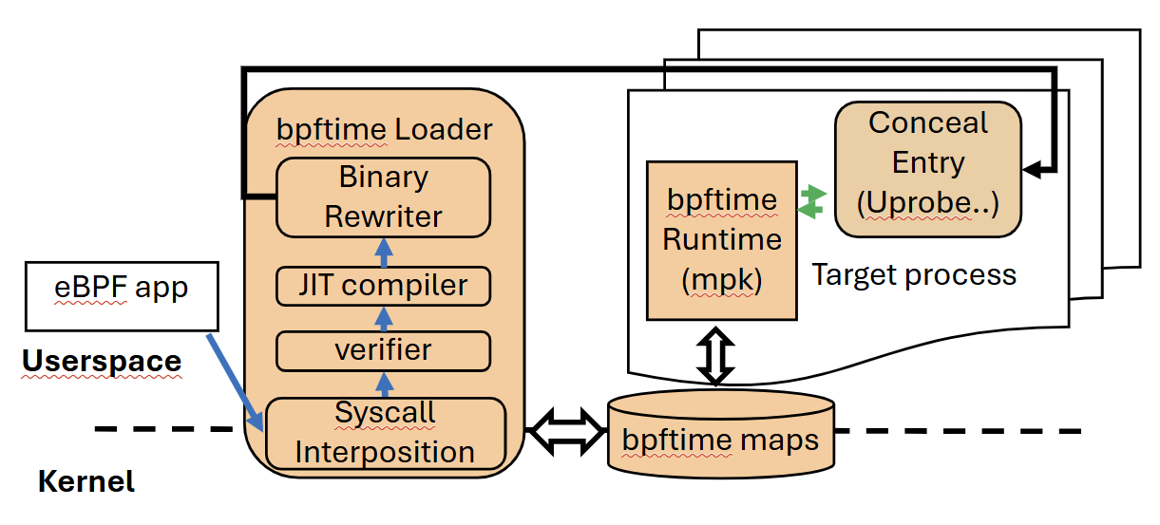
bpftime: userspace eBPF extension framework
Challenge for compatibility and efficiency:
eBPF: tightly coupled components
Bpftime: Intercept syscalls & Share memory maps
Notes:
Too complex, simplify the figture
Replace with High level summay

Slide 45
Host
Extension Runtime
Entry
Extension

Slide 46
Host
Extension Runtime
Entry
Extension

Slide 47
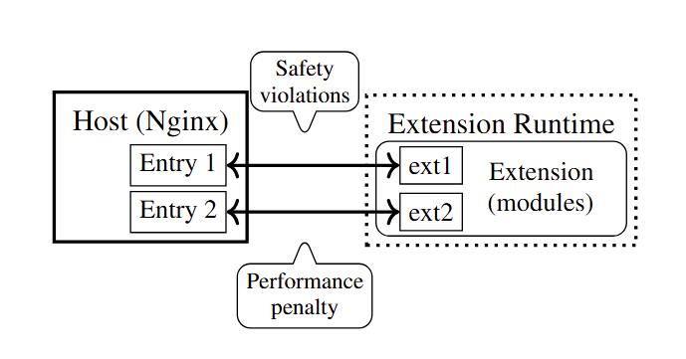
Safety violation
Performance penalty
Host
Extension Runtime
Entry
Extension

Slide 48
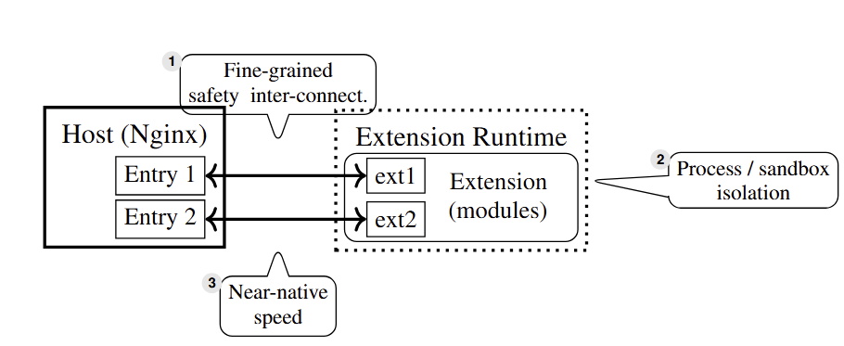
fine-grained safety and interconnectedness trade-offs
efficiency
Host
Extension Runtime
Entry
Extension
Isolation

Slide 49
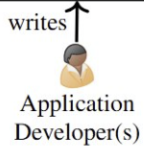
Stage 1: Development
Stage 2: Deployment​
Host
Host
Extension Runtime
Entry
Entry
Extension
Development time
EIM Spec
Development time
EIM Spec
Deployment time
EIM Spec
writes

Slide 50
Execution extension runtime in the same process for efficiency
Compatible with eBPF
eBPF app
Conceal extension entry for efficiency: using binary rewriting to remove unused extension entries
Process
Host
Bpftime
Runtime
bpftime Loader
EIM: no runtime cost
Entry
Extension
verifier
Hardware features for efficient isolation

Slide 51
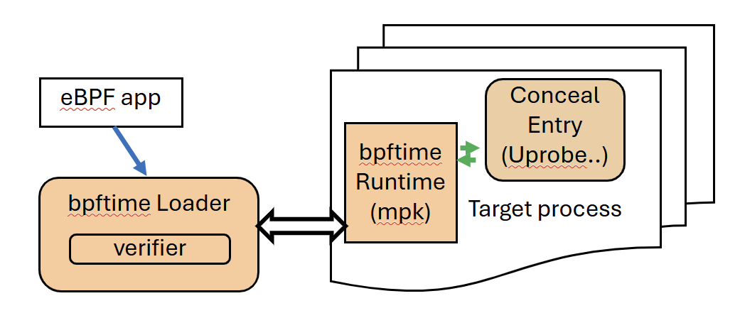
bpftime: userspace eBPF extension framework
Provide efficient solution to enforce EIM and isolation
Verification: EIM: no runtime cost
Execution extension runtime in thesame process forefficiency
Conceal extension entry for efficiency: using binary rewriting to remove unused extension entries
Hardware features for efficient isolation
Compatibility
Interact with kernel
Notes:
Too complex, simplify the figture
Replace with High level summay

Slide 52
EIM: Development-Time Specification
Developers annotate code for capabilities
Automatically extracted into capability manifest
Notes:
Maybe shorter annotation example? I think it needs one
We can redraw and make it much shorter
Tell people to look at paper and we are not talking about some detail
Do need some abstract
Looks like source code but it's a picture, no need to detail
Show they are short and what people are doing on it

Slide 53
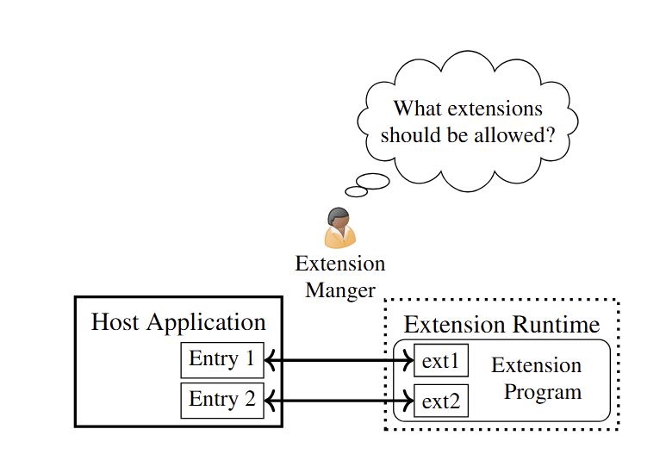
EIM: Deployment-Time Specification
Extension Manager write simple YAML policies to explore interconnectedness/safety trade-offs without recompiling

Slide 54
contribution
Background & motivation: Extensions
Extension Interface Model (EIM): Fine-grained Interface
bpftime Runtime: safety & performance
Evaluation
….. add more and make it a contribution
Q & A?
GitHub repo: https://github.com/eunomia-bpf/bpftime
Get started:
Notes:
Like roadmap
Say what is eim and what is bpftime
See the slide and understand the struct
Roadmap can be after
Roadmap is a signal for back to abstractions

Slide 55
Contribution
bpftime Runtime: An userspace eBPF runtime implemented EIM with isolation and efficiency
Extension Interface Model (EIM): Solution to navigate fine-grained safety-interconnectedness trade-off & Two-Phase Specification: Development-Time (by Developer) Deployment-Time (by Manager)
Evaluation: 6 usecases and Up to 6x less overhead
Notes:
Like roadmap
Say what is eim and what is bpftime
See the slide and understand the struct
Roadmap can be after
Roadmap is a signal for back to abstractions

Slide 56
Nginx firewall example
Offline:
Writes custom firewall logic using nginx helper functions
Loads their extension at an extension entry for request processing
At runtime
Nginx jumps to the extension runtime when reaches the extension entry
Extension runtime execute the extension entry and return to Nginx
Nginx
Extension Runtime
Entry
Firewall
Notes:
Too many examples, what are they? Why we want them?
Popular / high level exampl
What is ext
why we care about them

Slide 57
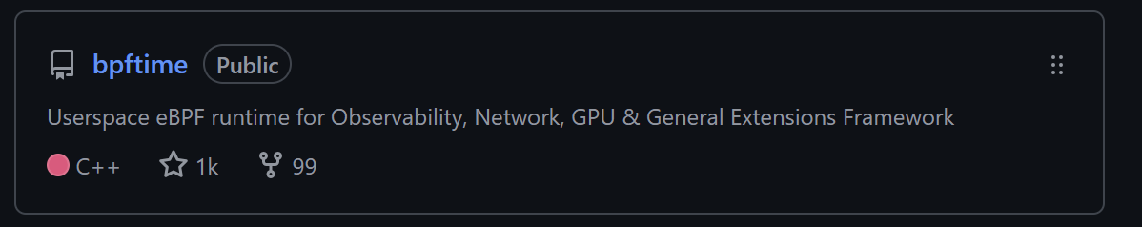
Six Real-World Use Cases
Nginx Firewall
Redis Durability
FUSE Metadata Cache
DeepFlow
Syscount
Sslsniff
(grounp and figture?)
GitHub: https://github.com/eunomia-bpf/bpftime
Notes:
Less detail

Slide 58
Extension Problems
Real-world safety violations:
Bilibili CDN outage, Apache buffer overflow, Redis RCE
Performance penalty: WebAssembly/Lua impose 10-15% overhead
Safety violation
Performance penalty
Host
Extension Runtime
Entry
Extension
Notes:
Use nginx example to illustrat it

Slide 59
contribution
Background & motivation: Extensions
Extension Interface Model (EIM): Fine-grained Interface
bpftime Runtime: safety & performance
Evaluation
….. add more and make it a contribution
Q & A?
GitHub repo: https://github.com/eunomia-bpf/bpftime
Get started:
Notes:
Like roadmap
Say what is eim and what is bpftime
See the slide and understand the struct
Roadmap can be after
Roadmap is a signal for back to abstractions

Slide 60

EIM: Extension Interface Model
Goal: enable fine-grained safety/interconnectedness trade-offs
Challenge: supporting per deployment tradeoffs
Solution:
Two-Phase Specification (Development-Time and deployment-Time)
Model all resources as capabilities
Extension
Development time
EIM Spec
Development time
EIM Spec
Extension Runtime
Host
Entry
Entry
Entry
During Development
Before Deployment​
At Deployment/Runtime​
Notes:
Introduction roles before it?
Modify the roles fig, make it simple and put it here
Can cite something here
Reintroduce it using nginx example, make everything around nginx

Slide 61
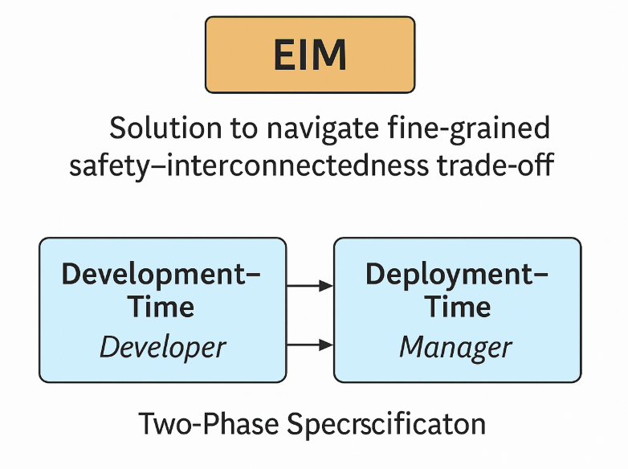
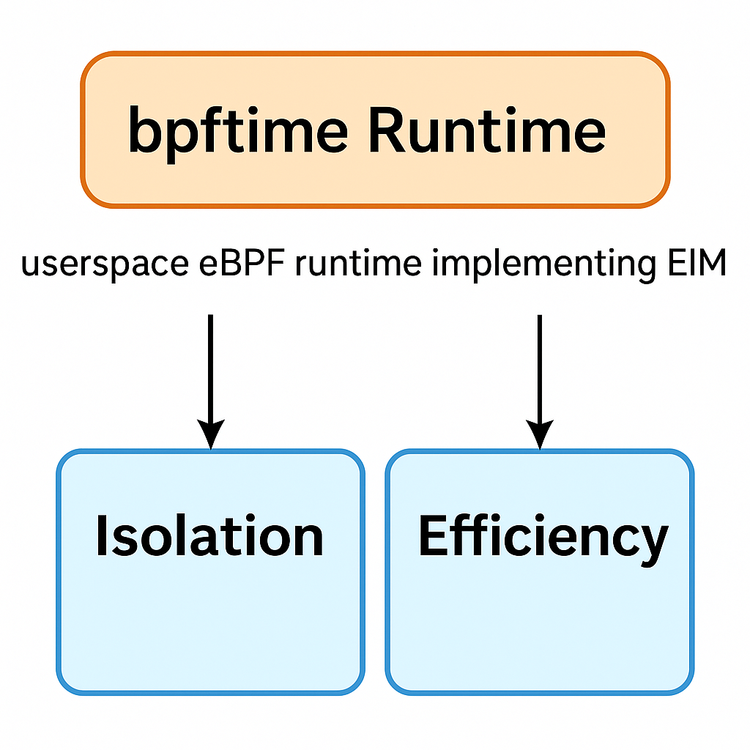
Contributions
bpftime
Extension Interface Model (EIM)
Up to 6x less overhead than current state-of-the-art!
Notes:
Like roadmap
Say what is eim and what is bpftime
See the slide and understand the struct
Roadmap can be after
Roadmap is a signal for back to abstractions

Slide 62
Contributions
Extension Interface model (EIM)
Bpftime runtime
Navigate fine-grained safety/interconectedness trade-offs for extensions
Efficient support for EIM and isolation through userspace eBPF runtime
Development time Spec
Developer
Deployment time Spec
Manager
Isolation
Efficiency
Two phase Specification
Up to 6x less overhead than current state-of-the-art!
Notes:
Like roadmap
Say what is eim and what is bpftime
See the slide and understand the struct
Roadmap can be after
Roadmap is a signal for back to abstractions

Slide 63
EIM: Extension Interface Model
Goal: enable fine-grained safety/interconnectedness trade-offs
Challenge: supporting per deployment tradeoffs
Solution:
Two-Phase Specification (Development-Time and deployment-Time)
Model all resources as capabilities
Host Application
Extension
Deploy Spec
Development time
EIM Spec
Deployment
time
EIM Spec
Writes
Extension Runtime
Verify
Writes
Extension
Entry
App Developer
Extension
Manager
Entry
Dev Spec
During Development
2. Before Deployment​
3. At Deployment/Runtime​
Notes:
Introduction roles before it?
Modify the roles fig, make it simple and put it here
Can cite something here
Reintroduce it using nginx example, make everything around nginx

Slide 64
Extension Requirements
Fine-grained safety and interconnectedness trade-offs
Isolation:
Efficiency:
fine-grained safety/interconnectedness tradeoffs
efficiency
Host
Extension Runtime
Entry
Extension
Isolation
Notes:
Use nginx example to illustrat it

Slide 65
EIM: Extension Interface Model
Goal: enable fine-grained safety/interconnectedness trade-offs
Challenge: supporting per deployment tradeoffs
Solution:
Two-Phase Specification (Development-Time and deployment-Time)
Model all resources as capabilities
Host Application
Deploy Spec
Development time
EIM Spec
Deployment
time
EIM Spec
Writes
Extension Runtime
Verify
Writes
Extension
Entry
App Developer
Extension
Manager
Entry
During Development
2. Before Deployment​
3. At Deployment/Runtime​
Notes:
Introduction roles before it?
Modify the roles fig, make it simple and put it here
Can cite something here
Reintroduce it using nginx example, make everything around nginx

Slide 66
Extension Problems & requirements
Real-world safety violations:
Bilibili CDN outage, Apache buffer overflow, Redis RCE
Performance penalty:
WebAssembly/Lua impose 10-15% overhead
Requirements:
Fine-grained safety and interconnectedness trade-offs
Isolation
Efficiency
Safety violation
Performance penalty
efficiency
Host
Extension Runtime
Entry
Extension
fine-grained safety/interconnectedness tradeoffs
Isolation
Notes:
Use nginx example to illustrat it

